Slide 1
CSC 557 Project
Smart Industrial Power Systems
&
Industry IOT Telemetry Systems
Pre-Analysis by
Chitti Lakshmi “Deepak” D
Venkata Krishna “Govind” S
Aditya B

Slide 2
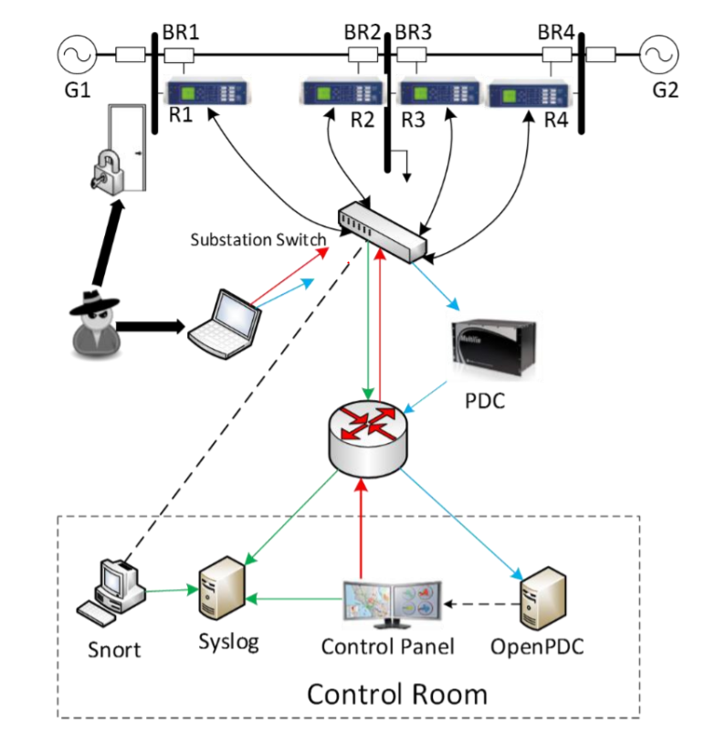
Introduction
A distributed control system (DCS) is a digital process control system for a process or plant, wherein controller functions and field connection modules are distributed throughout the system.
This project primarily discuss the various types of attacks on the power systems which are monitored and controlled by a cyber system through a network.
Power-system disturbances and several cyber attacks are simulated on the test bed configuration and data sets are collected from 25 different scenarios.

Slide 3
Problem Statement
The next-generation electric power grid will rely on many advanced and smart technologies in order to meet the increasing demand for reliable energy. This creates a tight interaction of cyber-infrastructure with the physical infrastructure of the power system and there is a high chance of cyber penetration and attacks, on the power system. To prevent the cyber attacks, system must be integrated with an automated security system where data science techniques are used to learn the common paths, provide a specification or signature for each scenario. The automatic approach eliminates the need to manually analyze and manually code patterns and is able to handle very large amounts of data.

Slide 4
(CPS)Parameters of the system
Intelligence-In this system, there are multiple intelligent devices that can switch the circuit breakers on and off.
Network- A Bayesian network is used to graphically encode the causal relations among the available information to create patterns with temporal state transitions, which are used as rules in the proposed intrusion detection framework.
Resilience-Various machine learning techniques are evaluated for disturbance discriminators
Interoperability-power systems are large interconnected systems. Changes outside the monitored portion of the power system may lead to variability in observed measurements
Security-Intrusion detection systems (IDSs) identify activities that violate the security policy of a computer system or network.

Slide 5
Challenges
The increasing coupling of cyber infrastructure and physical devices of the smart grid makes it vulnerable to several cyber attacks.
Traditional host based intrusion detection systems are inadequate to the current power systems as multiple control systems are distributed over multiple places.
Currently, the common paths mining-based IDS builds common paths from captured data logs. Capturing such data logs for real systems is difficult.

Slide 6
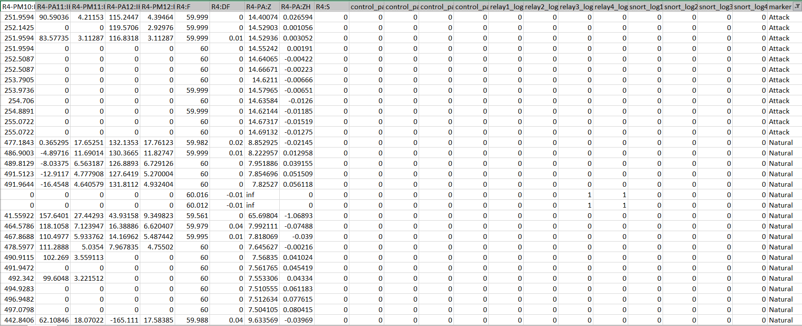
Datasets
Datasets include data logs associated with 10 000 simulated instances of the 25 aforementioned scenarios. The data log includes 56 sensor measurements and a test scenario. The 56 data sources consist of 52 synchrophasor measurements; 13 from each relay location. Relay status information, breaker events, Snort alerts, and control panel alerts were also logged.

Slide 7
Overview of IOT Telemetry system
Introduction | In the Cyber Range Labs of UNSW Canberra, a testbed network for the industry 4.0 network that includes IoT and IIoT devices and services was. The testbed generates a new systematic testbed of Industry 4.0/Industrial IoT (IIoT) networks for creating new realistic datasets
Problem Statement | Collecting and analysing heterogeneous data sources from the IOT/IIOT are essential for training and validating the fidelity of cybersecurity applications-based machine learning. However, the analysis of those data sources is still a big challenge for reducing high dimensional space and selecting important features and observations from different data sources.The datasets and their analysis would improve the validations of different cybersecurity applications based on statistical models, machine/deep learning models, and riching data assets of cybersecurity and IoT applications.
Challenges | Non-availability of heterogeneous data sources
Datasets | The datasets were collected from a realistic and large-scale network designed at the IoT Lab of the UNSW Canberra Cyber. The testbed was designed based on interacting network and IoT systems with the three layers of edge, fog and cloud to mimic the realistic implementation of recent real-world IoT networks. Hacking scenarios were utilized to launch nine attack categories against vulnerable elements of IoT/IIoT applications, operating systems, network systems.

Slide 8
Security Principles
CPS | Smart Industrial Power Systems | IOT Telemetry Systems
Confidentiality | Corrupt control and measurement signals can be disguised as power-system disturbances or control actions | Vulnerable to scanning and backdoor attacks
Integrity | Disturbance can lead to improper response and cause an outage or other negative impacts on the power system | Vulnerable to Injection attack
Availability | Transmission line fault, can initiate a chain of reactions, which lead to a cascading blackout | Denial of Service and Distributed Denial of service attacks are implemented
Authentication | Despite having Password authentication, cyber attacks targeted towards substation computers and devices can interrupt the electric power system communications, prevent real time monitoring of the power system | Vulnerable to Password Attack

Slide 9
6-point Rubric Evolution for Smart Power Systems
Matrix | Datasets
CPS | Smart Industrial Power Systems | IOT Telemetry Systems
Datasets Location | http://www.ece.uah.edu/~thm0009/icsdatasets/triple.7z | https://cloudstor.aarnet.edu.au/plus/s/ds5zW91vdgjEj9i?path=%2FProcessed_datasets%2FProcessed_Network_dataset
Does it include network data? | No | Yes
Does it include heterogeneous datasets? | No | Yes
Does the dataset strive for scalability? | No | Yes
Does the dataset address aspects of security in CPS? | Yes with anomalies | Yes with anomalies
Does the dataset address aspects of privacy in CPS? | Yes | Yes
Does the dataset address a specific aspect of CPS? | Yes, Security and Automation | Yes, Threat Intelligence and Privacy preservation

Slide 10
Future
Future work is required to limit the amount the number of captured scenarios instances required to train the algorithm and to update the IDS to perform real time classification from live system inputs and to incorporate the classifier with an intelligent adaptive control framework to achieve increased automation in of power systems.
Work is required to make learning-based systems deployable in an operation environment. Moreover, the results need to be validated on a broader set of power system data and with a wider variety of learning approaches, classification schemes, and amounts of labeled data. In addition, more work is required in understanding the concept of operations associated with these systems, such as methods for determining training and retraining needs, approaches for generating and managing labeled data, in-situ evaluation tools to select the optimum learner and tune the performance of that learner in that specific deployed environment.

Slide 11
References
Developing a Hybrid Intrusion Detection System Using Data Mining for Power Systems - http://ieeexplore.ieee.org/stamp/stamp.jsp?tp=&arnumber=7063234&isnumber=5446437
Classification of Disturbances and Cyber-attacks in Power Systems Using Heterogeneous Time-synchronized Data - http://ieeexplore.ieee.org/stamp/stamp.jsp?tp=&arnumber=7081776&isnumber=4389054
A Specification-based Intrusion Detection Framework for Cyber-physical Environment in Electric Power System - http://ijns.jalaxy.com.tw/contents/ijns-v17-n2/ijns-2015-v17-n2-p174-188.pdf
Machine Learning for Power System Disturbance and Cyber-attack Discrimination - https://doi.org/10.1109/ISRCS.2014.6900095
Anomaly detection for cybersecurity of the substations - https://ieeexplore.ieee.org/abstract/document/6003810
TON_IOT datasets https://ieee-dataport.org/documents/toniot-datasets
TON_IOT Data description - https://cloudstor.aarnet.edu.au/plus/s/ds5zW91vdgjEj9i/download?path=%2F&files=Testbed%20%26%20attacks%20of%20TON_IoT%20datasets.pdf

